Slide 1

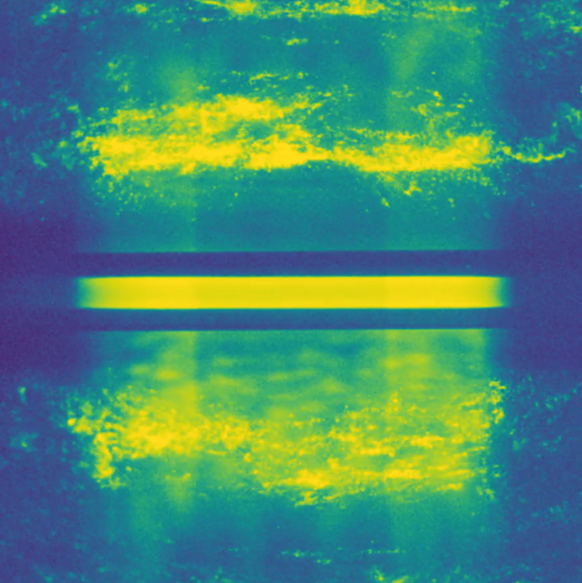



NSDF@CHESS
Democratizing Data Access at the Cornell Light Source through FABRIC services
Presenters: Giorgio Scorzelli and Valerio Pascucci
Scientific Computing and Imaging Institute (SCI)
University of Utah
https://shorturl.at/ciBO1

Slide 2
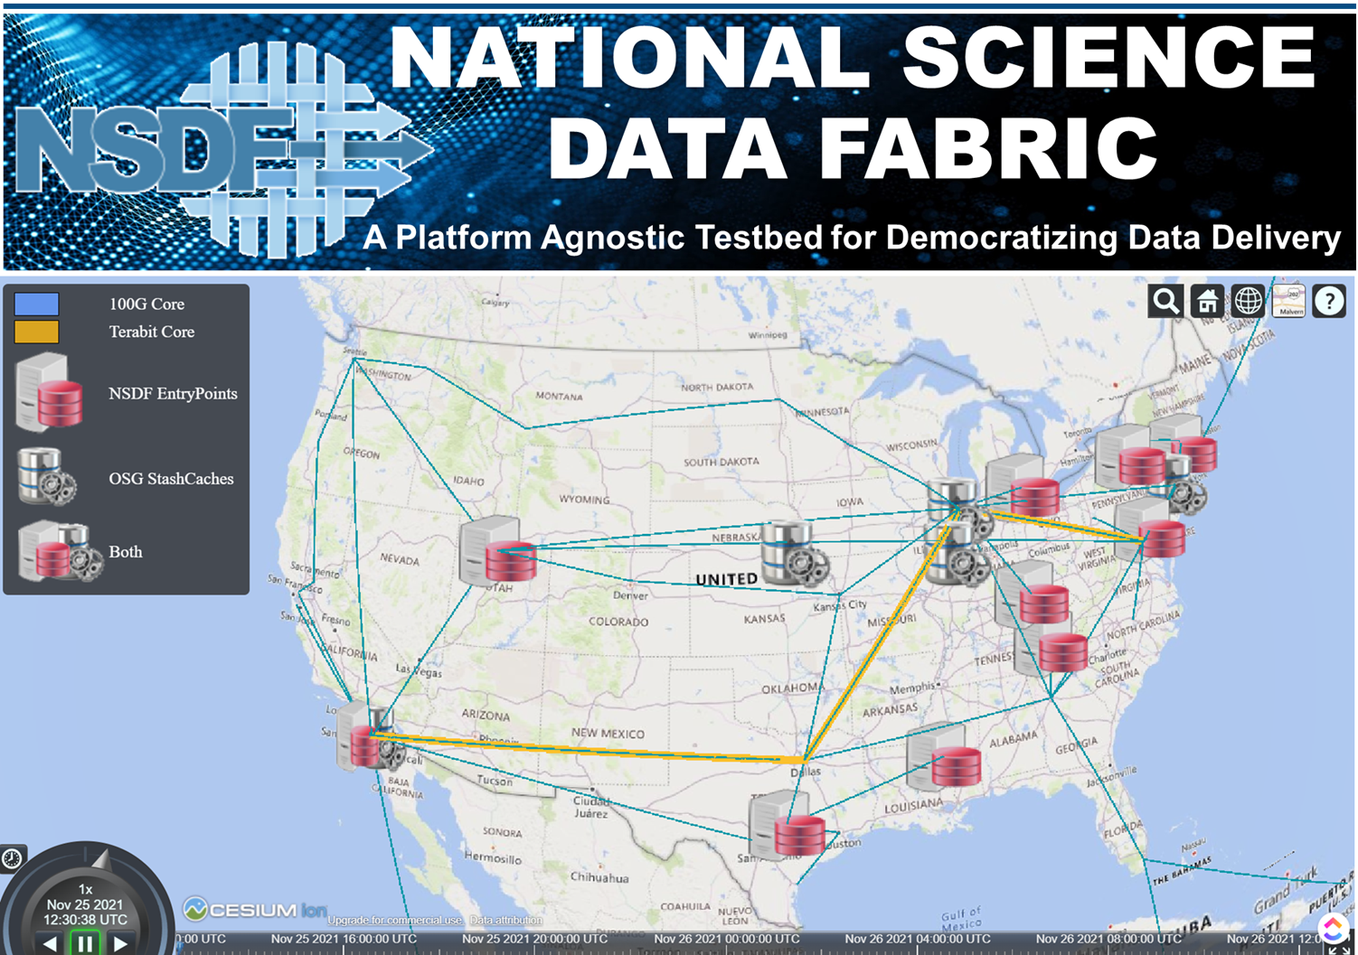
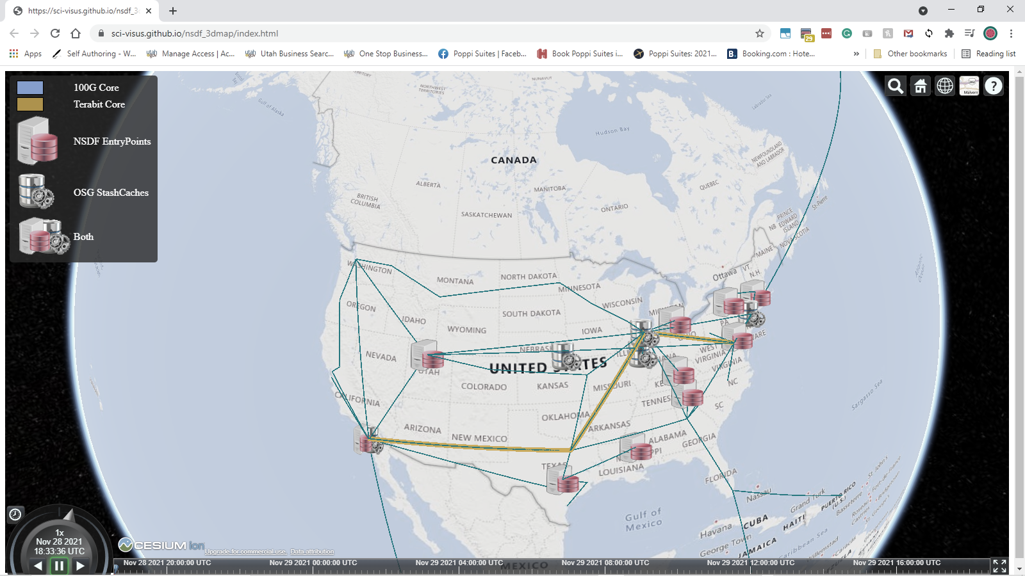

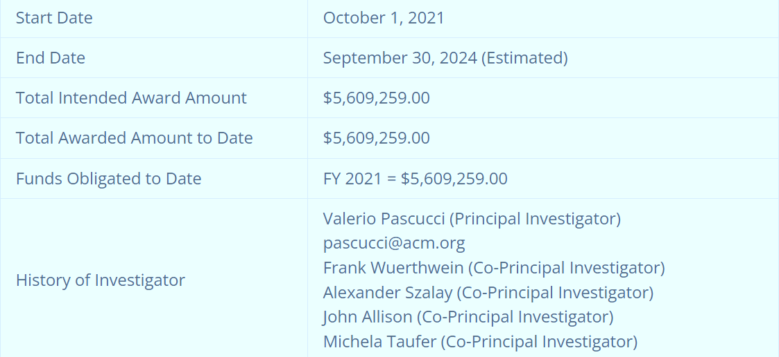






https://nationalsciencedatafabric.org

Slide 3
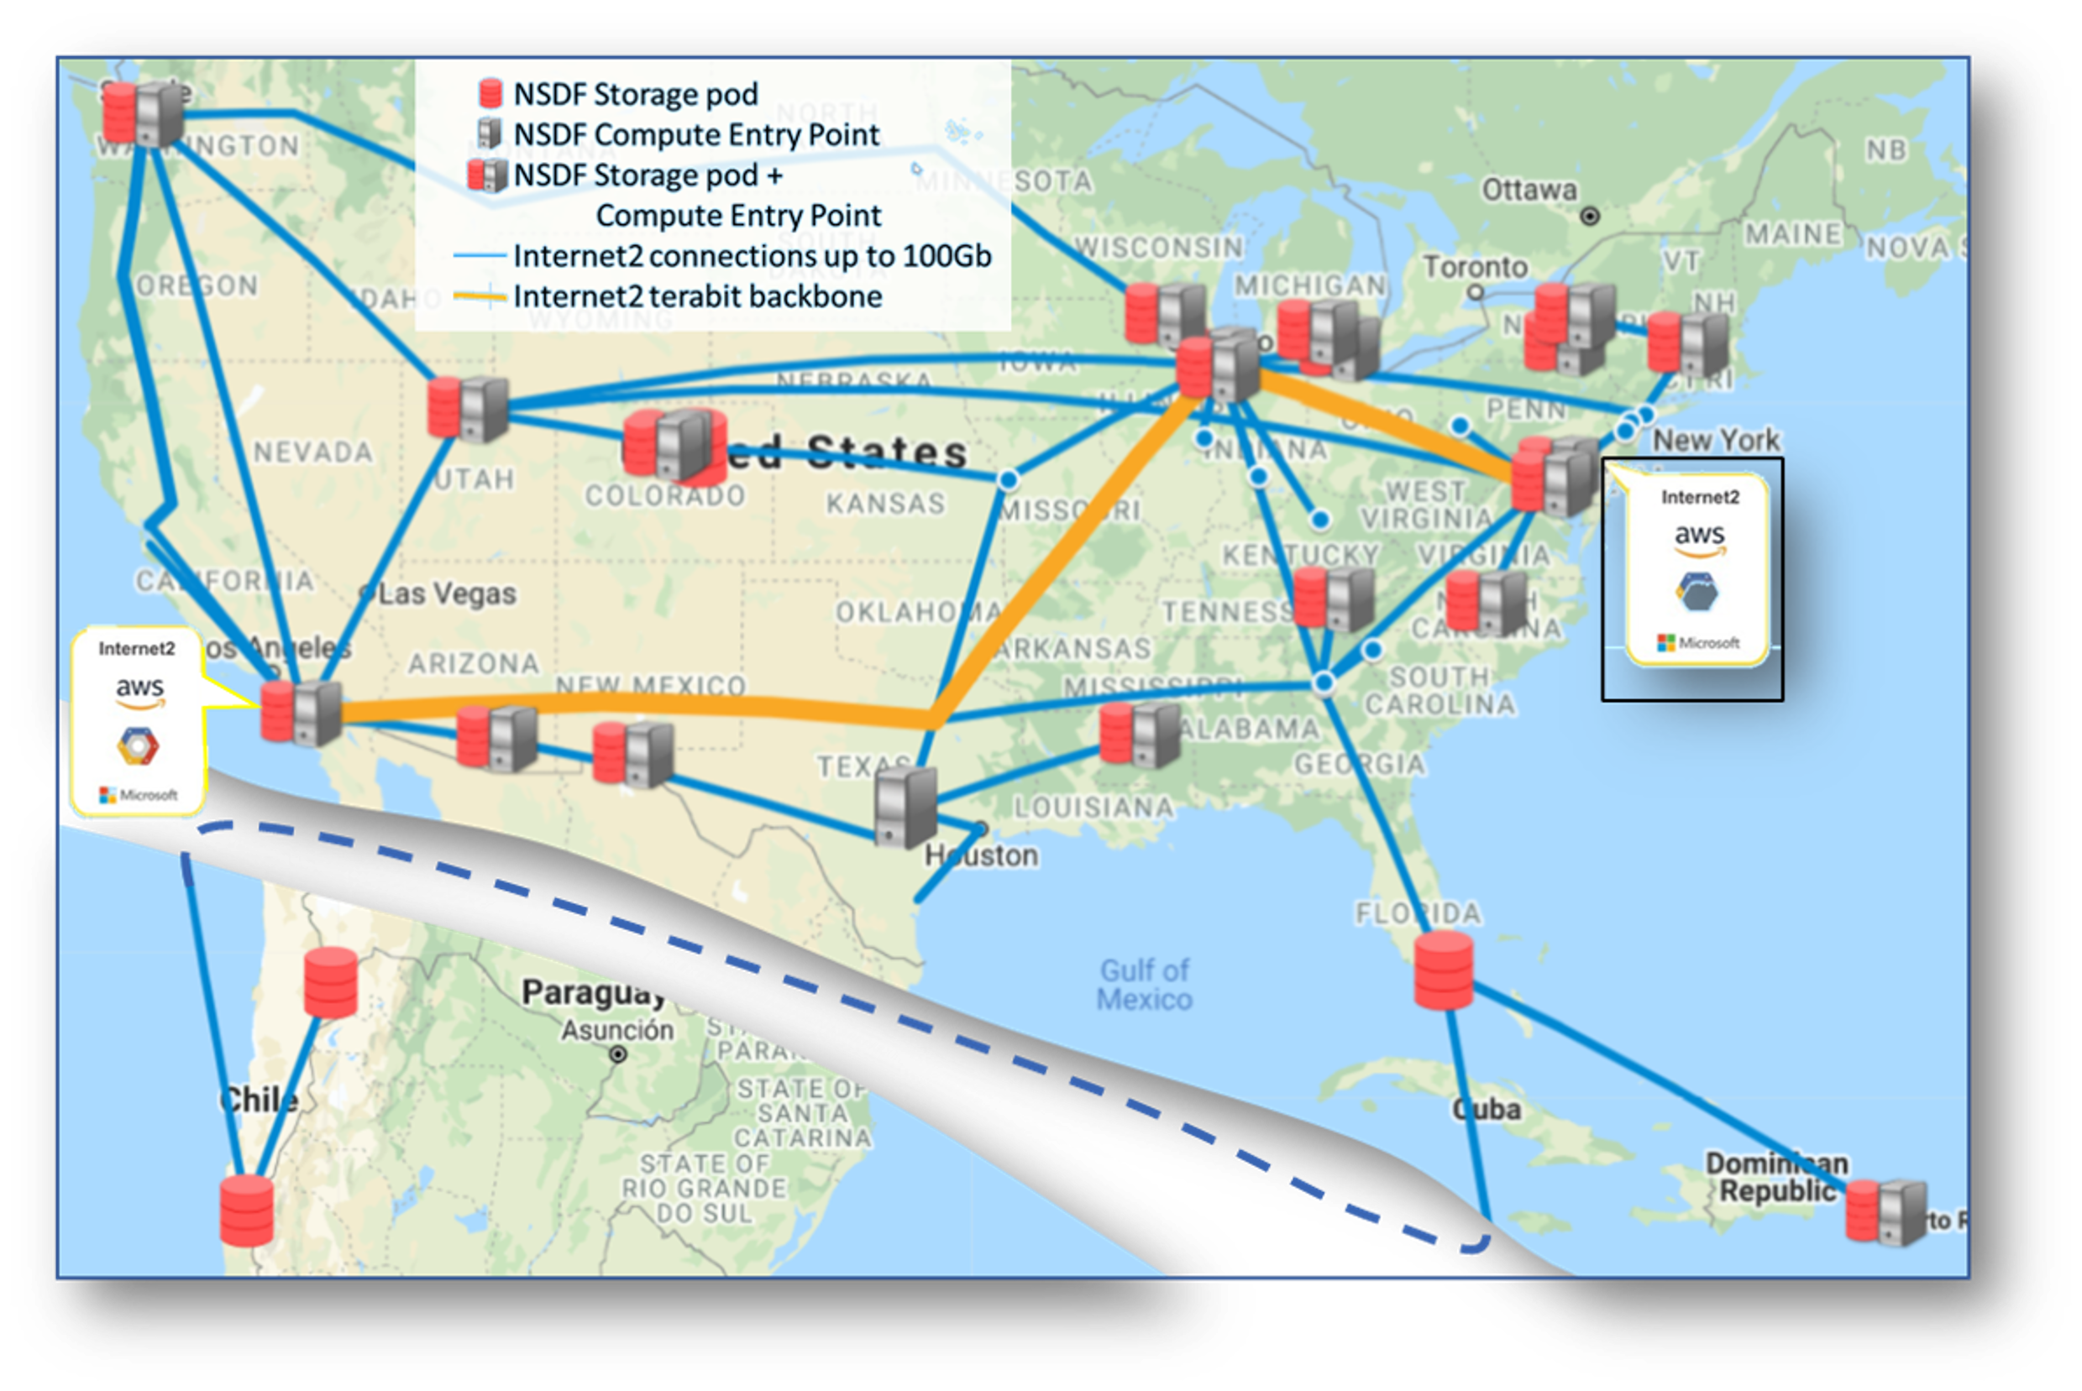

NSDF Overview
The NSDF mission is to democratize access to large-scale scientific data by developing production-grade scalable solutions to data storage, movement, and processing that can be deployed on commodity hardware, cloud computing, and HPC resources.
Provides integrated access to:
Shared storage
Networking
Computing
Through deployment of:
Hardware components
Software tools
Training activities
Education
NSDF sites are connected by the
INTERNET2 backbone
The NSDF vision is to establish a globally connected infrastructure in which scientific investigation is unhindered by the limitations of extreme data.

Slide 4


NSDF system of system approach
NSDF is an NFS-funded project, and it is connecting/interoperating/collaborating with other NFS-founded projects
NSDF helps NSF scientific communities and collaborators and others to be lock-free:
Chameleon Cloud NSF-funded testbed system for Computer Science experimentation.
XSEDE NSF-funded system.
CloudBank NSF-funded project.
CloudLab NSF-funded project .
CyVerse NSF-funded for data storage, bioinformatics tools, data visualization, cloud services.
OSG /OSDF NSF-funded project High Throughput Computing services.
OSN NSF-funded for data storage.
VDC NSF-funded for data-intensive, interdisciplinary, and collaborative research.
FABRIC NSF-funded for Adaptive Programmable Research Infrastructure for Computer Science and Science Application

Slide 5


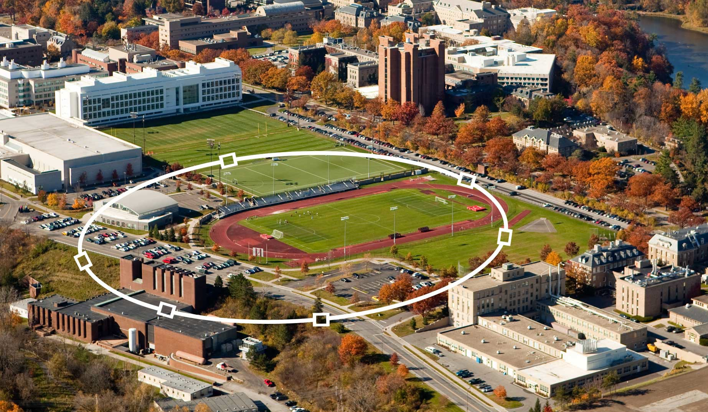
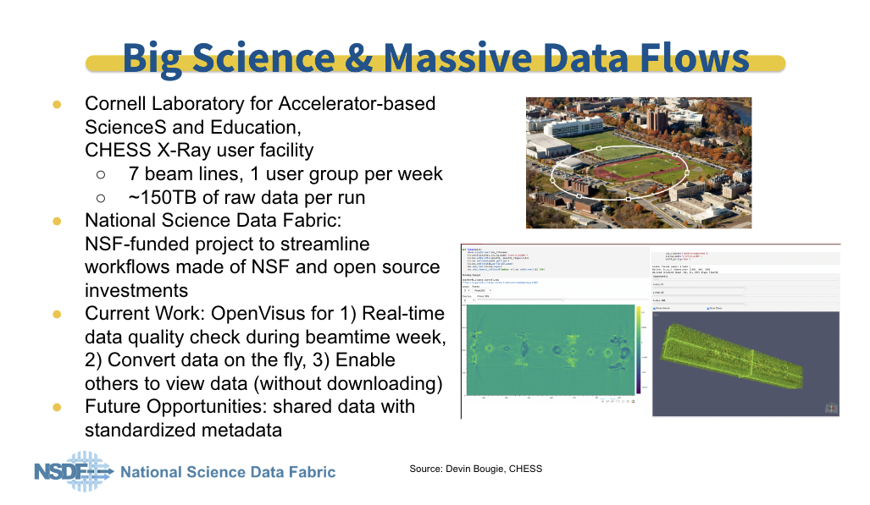
Cornell Laboratory for Accelerator-based Science and Education
https://www.chess.cornell.edu https://www.classe.cornell.edu/Research/
CHESS X-Ray user facility
Three sub-facilities, supported by the NSF, NIH, and AFRL
Macromolecular crystallography, structural biology, chemistry, quantum materials, and material science
New Experimental Hall to house the 20 Tesla High Magnetic Field beamline
Particle Physics and Astrophysics
•
•
•
7 beam lines, 1 user group per week
150TB of row data per run

Slide 6
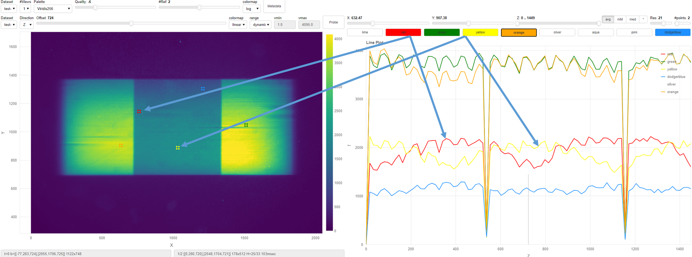
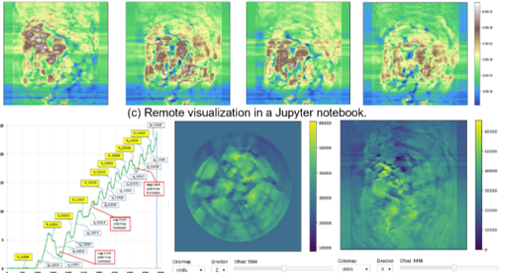



NSDF-Light Sources activities
User requirements and preferences:
Significant demand for Jupyter Notebooks
Some users don’t want to deal with Python packages problems
Some users just want an URL
No matter if the data is big
Distributed teams of scientist:
real-time access to the beamlines of CHESS
During the acquisition of new data, steer the experiments (too optimistic?)
Experimental facilities:
Cornell High Energy Synchrotron Source (CHESS)
National Synchrotron Light Source II @Brookhaven National Laboratory
The Advanced Photon Source (APS) @Argonne National Laboratory

Slide 7

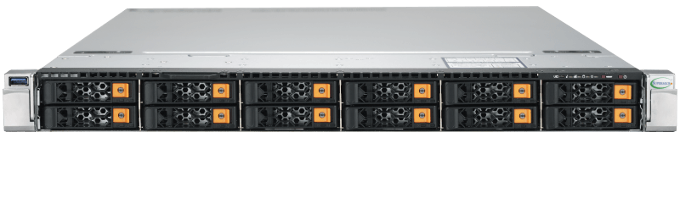
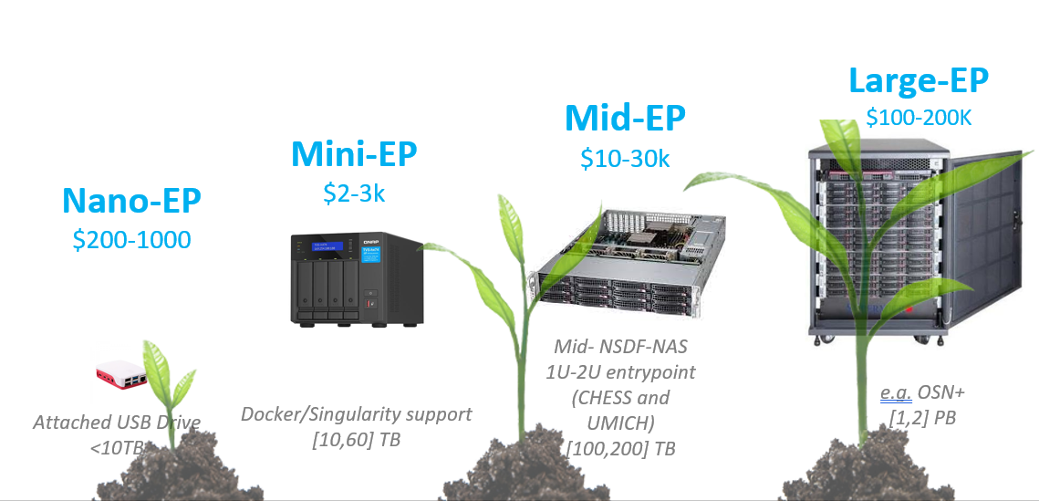
Decoupling data from storage
52 cores
512GB RAM
1TB Solid State Drive.
144 TB of HDD
25Gb/sec
Data need to be converted to Streamable format
Can use a POSIX file system
Better use SSD for converting data
But HDD will work too (e.g., NSDF chess entry point ~192 TB HDD)
Can use an NFS mount
Better for Read-Only since file-opening file-locking is SLOW
We are hardware agnostic

Slide 8
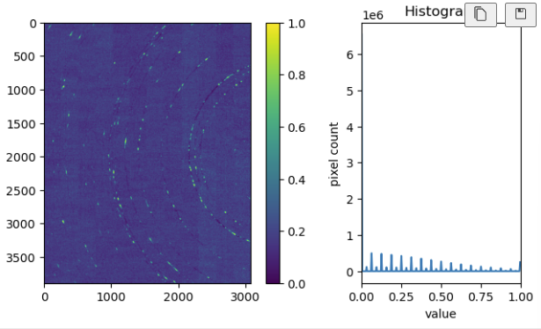
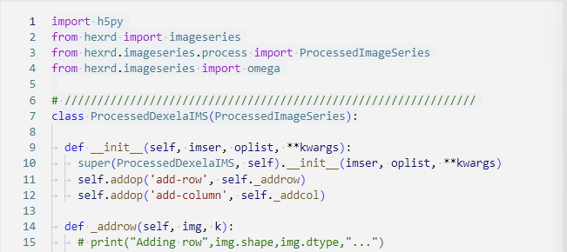
CHESS – Far field
/allison-1110-3/mg4al-sht/133/ff/ff2_000406.h5
1445 uint16 x (3888, 3072) - 33GB uncompressed - file_size=33GB
Jupyter Notebook
Significant PREPROCESS STEP
class ProcessedDexelaIMS(ProcessedImageSeries)
dark = imageseries.stats.median(raw, nframes=100)

Slide 9
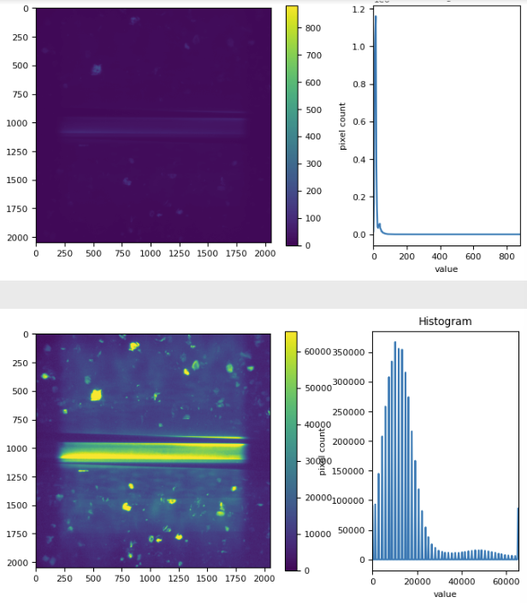
CHESS – Near Field
/allison-1110-3/mg4al-sht/11/nf/nf_009494.tif
1447 uint16 x (2048, 2048) - 12GB uncompressed - overall file_size=12 GB
Jupyter Notebook
Compute histogram
Equalized images with histogram
We can crop, percentile, etc.

Slide 10

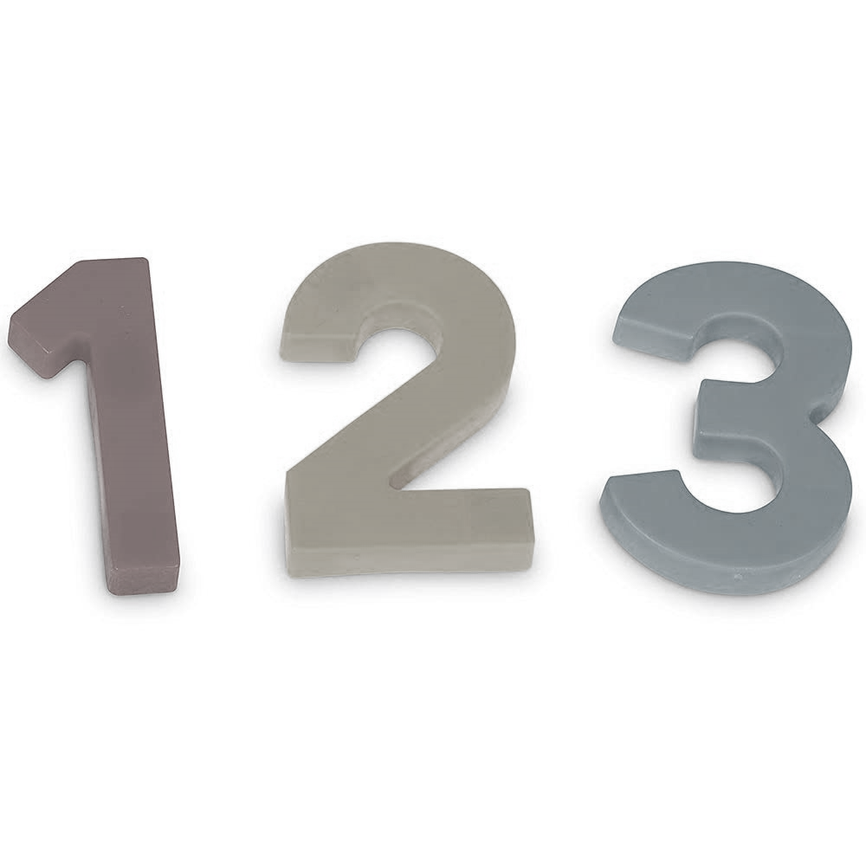

CHESS RAW numbers
33GB HDF5 (far-field) will take ~5 minutes to acquire/store
112 MB/sec
1 TB/hour
23 TB/day
CHESS produces ~1TB/day/beamline during the hot time

Slide 11
CHESS raw numbers
12GB IMAGE-STACK
SRC=/nfs/chess/nsdf01/vpascucci/allison-1110-3/mg4al-sht/11/nf
du -h ${SRC} # DST=/mnt/data1/nsdf/remove-me/nf mkdir -p ${DST} time rsync -ah --progress ${SRC} ${DST}
# 36 seconds == ~340MB/sec
We can copy HDF5 file to the NSDF entry point in less than 2 minutes
sustained ~300MB/sec
19GB/min
1 TB/hour
28TB/day
54GB HDF5
SRC=/nfs/chess/daq/current/id3a/nygren-3738-a/ss718-1ff
du -h ${SRC} # DST=/mnt/data1/nsdf/remove-me/ff mkdir -p ${DST} time rsync -ah --progress ${SRC} ${DST}
# ~ 300MB/sec

Slide 12

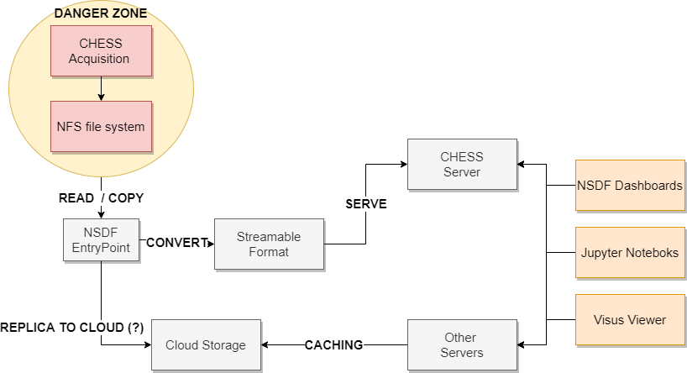
FABRIC integration with NSDF@CHESS OVERALL PICTURE

Slide 13
FABRIC integration with NSDF@CHESS Async / Decoupled Architecture
Converter up-and-running 100%/ high-available is not feasible
Converter runs on the EntryPoint(s)
The single convert must be an IDEMPOTENT
The converter WILL crash / fail
Run two times should not a big deal
It should restart from where it left

Slide 14
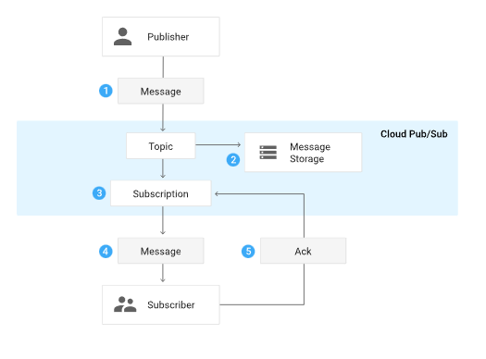

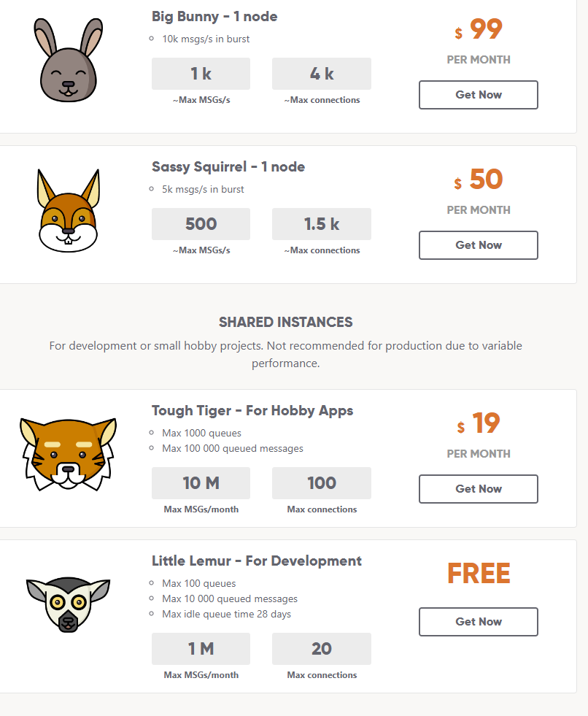
FABRIC integration with NSDF@CHESS
Async/Decoupled architecture
Use an API Gateway-Like running inside CHESS
Using RESTful API to perform actions
Another in-house service to keep up-and running
Need some maintenance/monitoring/etc.
Use a managed PubSub system
With no sensitive data
Can dispatch thousands of events (not millions)
Can be replaced by an NSDF service easily
Should be ready for scaling/high availability
Should be nearly zero cost
Kafka, Google PubSub, Redis PubSub ... ,RabbitMQ

Slide 15
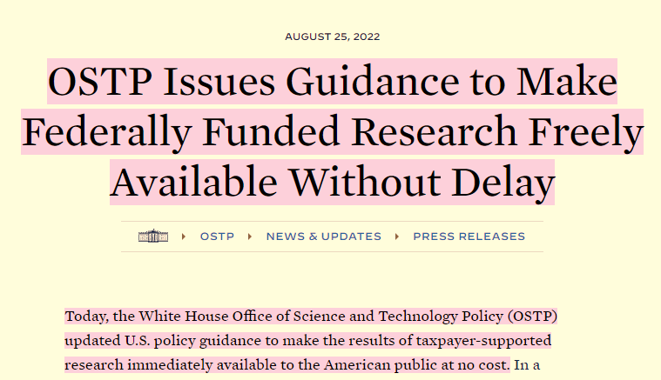

FABRIC integration with NSDF@CHESS
Data serving
Link
Data on the NSDF CHESS EntryPoint
Cannot LIVE forever there
Automatic transfer to the outside?
We may provide Cloud/Distributed Storage public Data (some PB)
Even multi-server

Slide 16
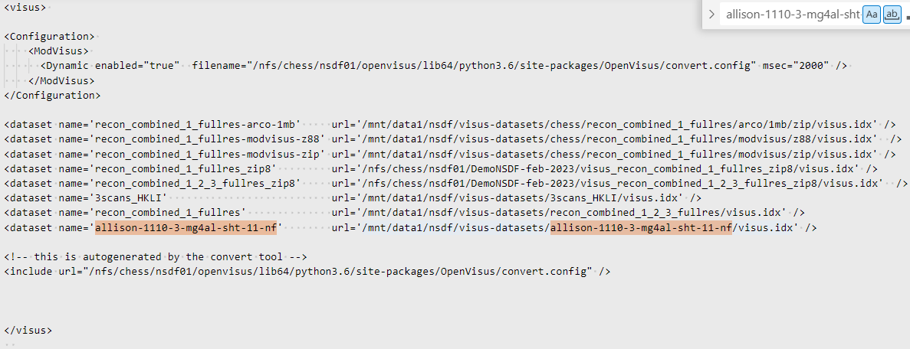
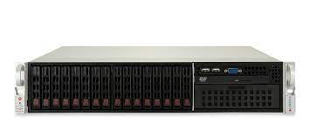
Fabric integration with NSDF@CHESS
DATA SERVING
new datasets are detected in <2 seconds

Slide 17
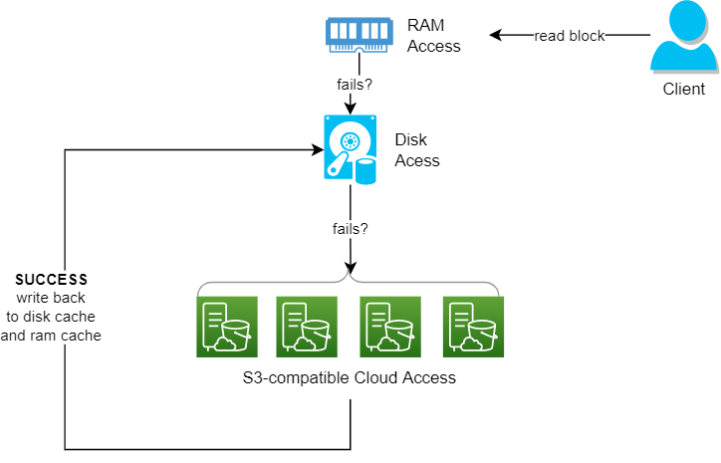
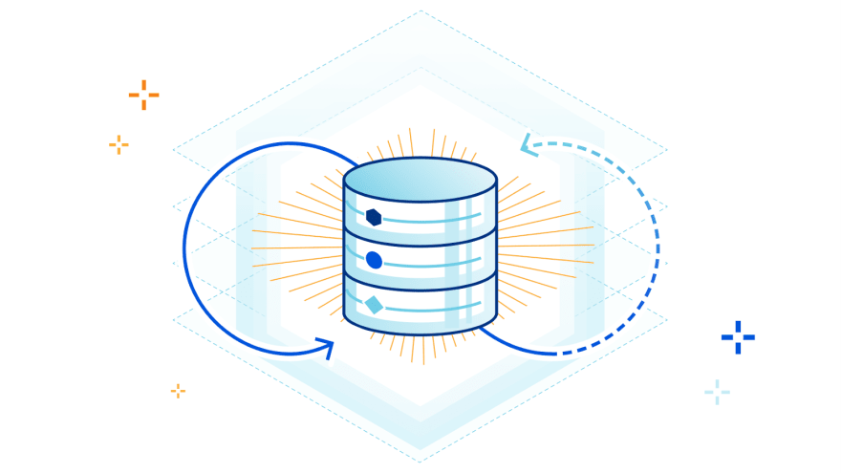
FABRIC integration with NSDF@CHESS architecture: DATA CACHING
SSD (100$/TB) -> HDD 10$/TB -> S3 Storage (5$/TB) -> Tape (<<1$/TB)
Even shard requests to multiple cloud storage to avoid vendors lock-in

Slide 18
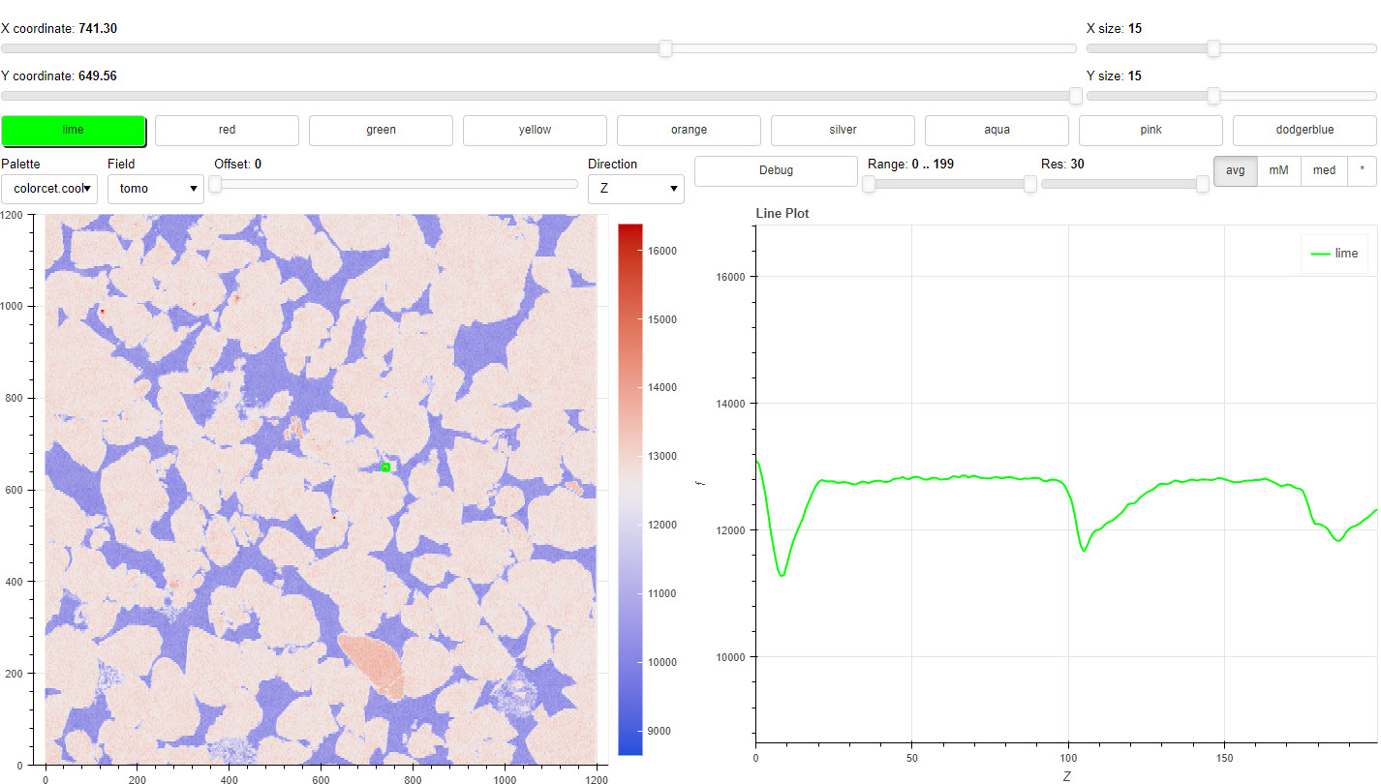




FABRIC integration with NSDF@CHESS architecture DATA VISUALIZATION
RUNNING “OUTSIDE”

Slide 19
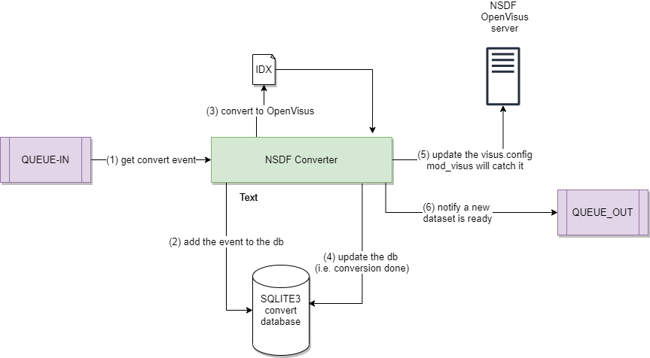

FABRIC integration with NSDF@CHESS
OVERALL

Slide 20
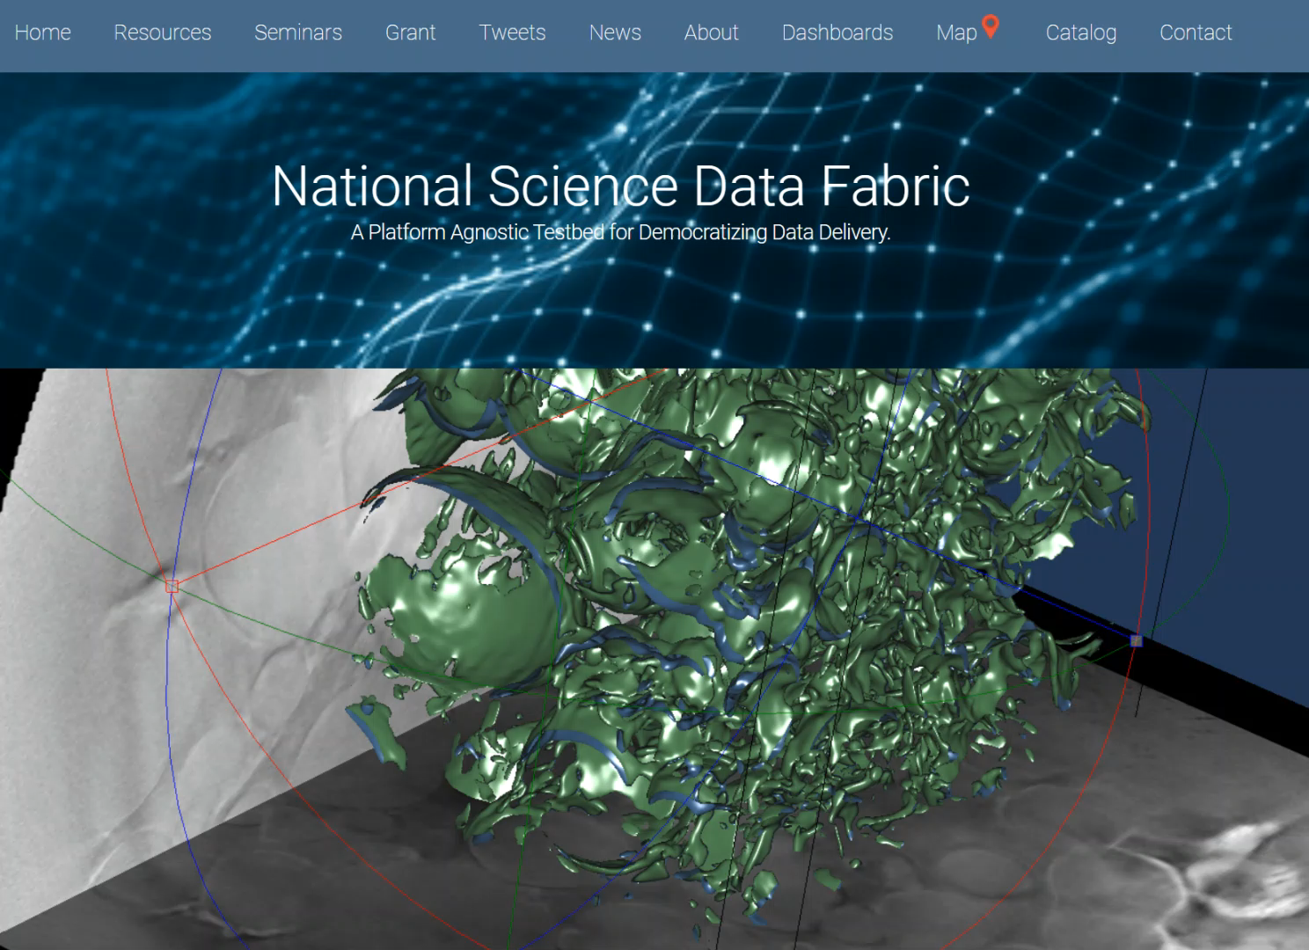
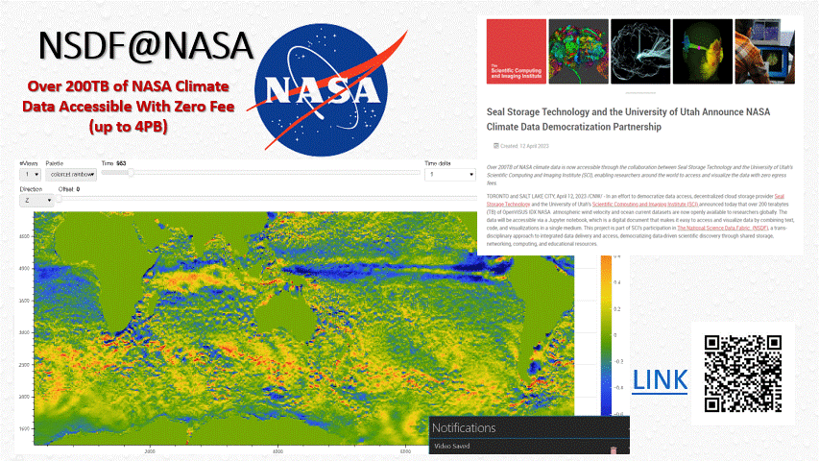
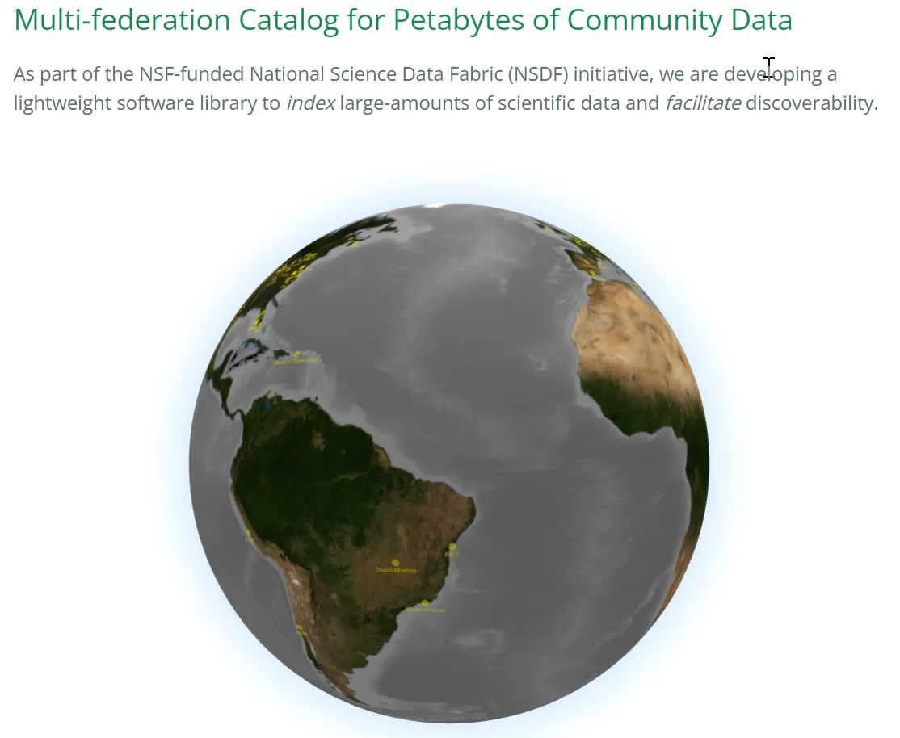

Join Demo Night

Slide 21



If Wi-Fi is not too slow
ssh NSDF-chess
http://66.70.176.206:10334/app
http://142.44.214.73:10334/app
http://54.39.133.137:10334/app

Slide 22
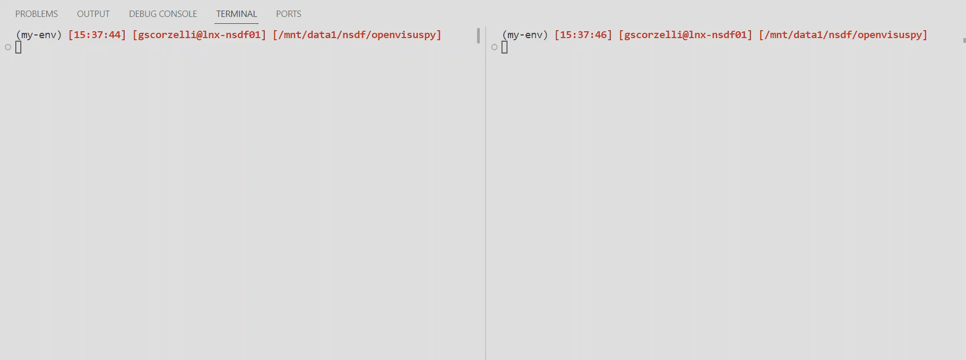
If Wi-Fi is too slow…
NSDF ENTRYPOINT converter
CHESS BEAMLINE

Slide 23
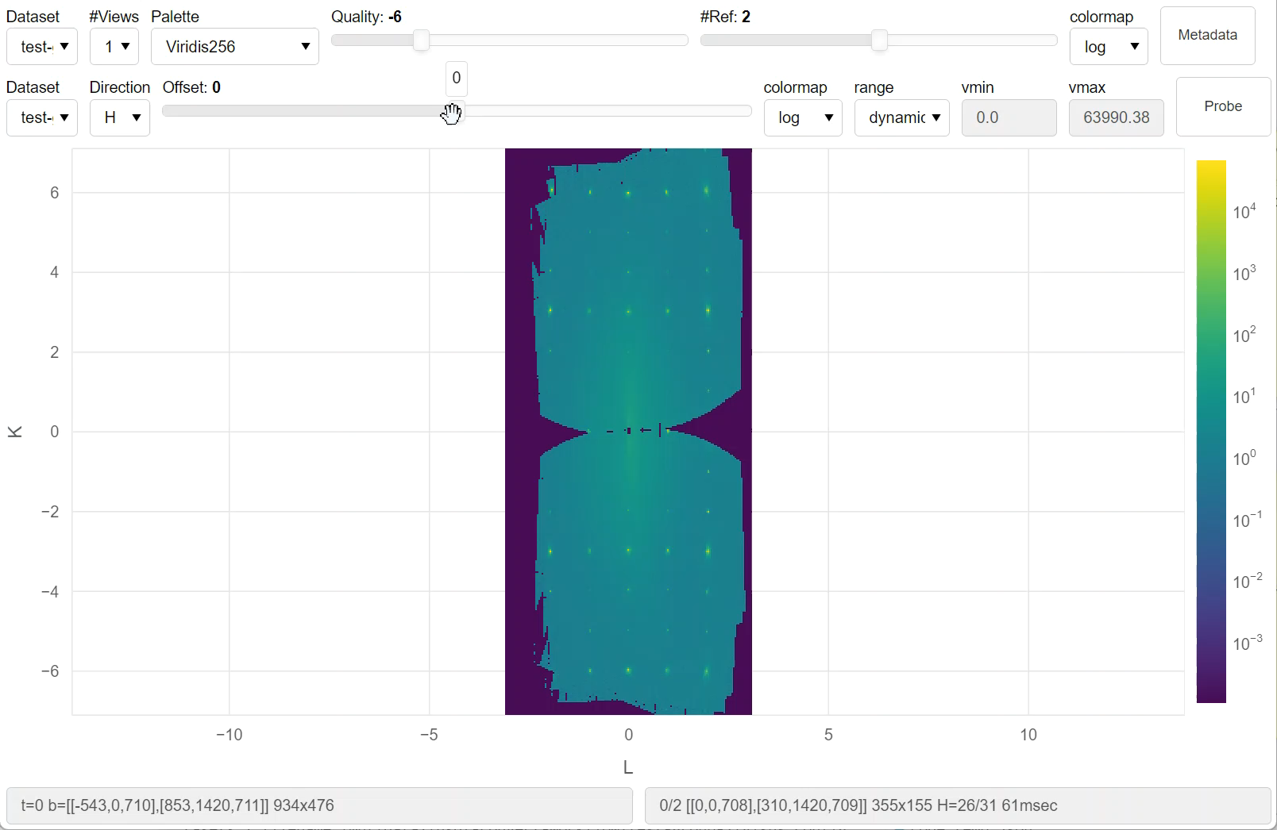
On the Fabric side
If Wi-Fi is too slow

Slide 24


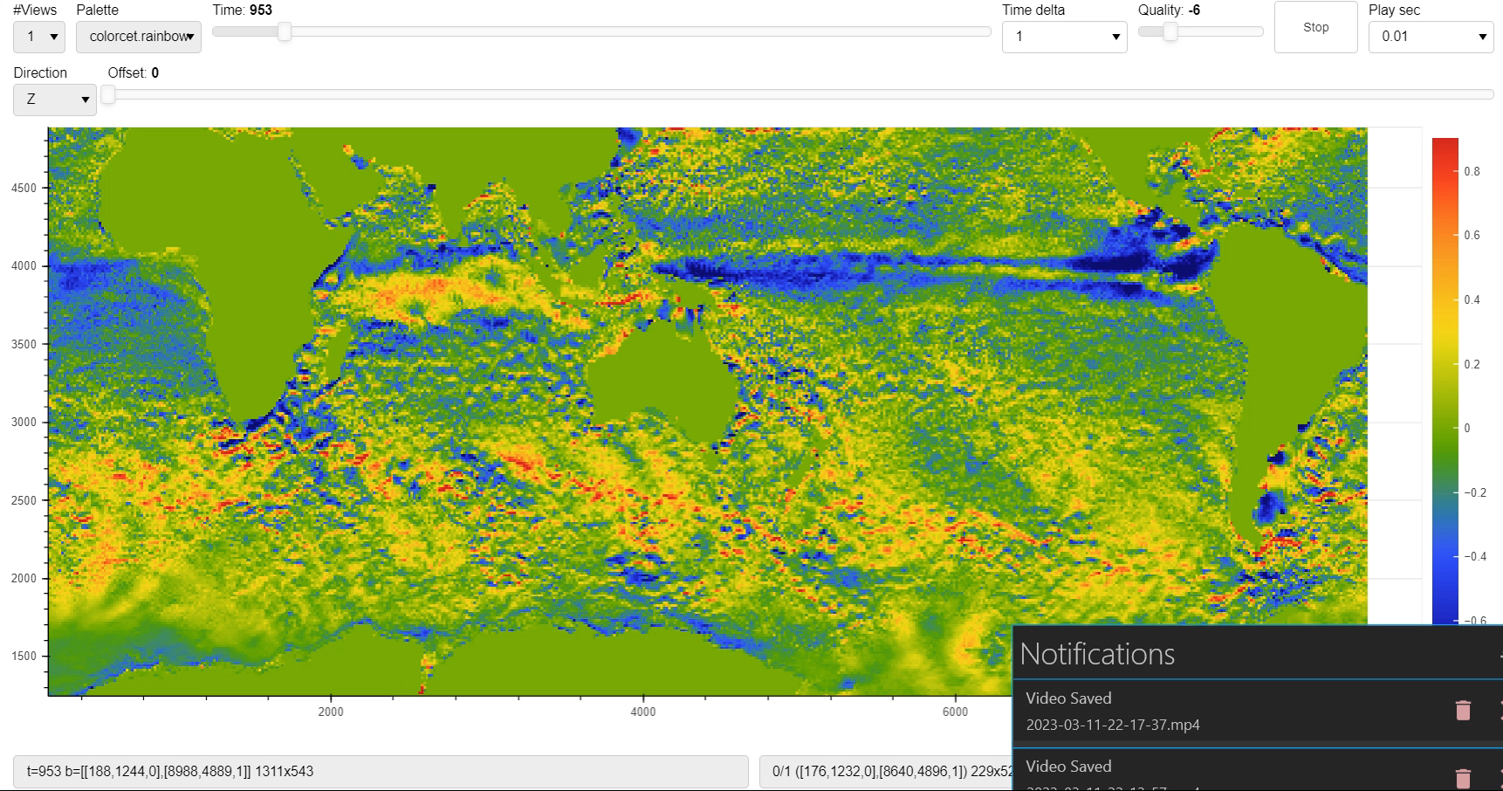

NSDF@NASA
Over 200TB of NASA Climate Data Accessible With Zero Fee
(up to 4PB)
LINK

Slide 25
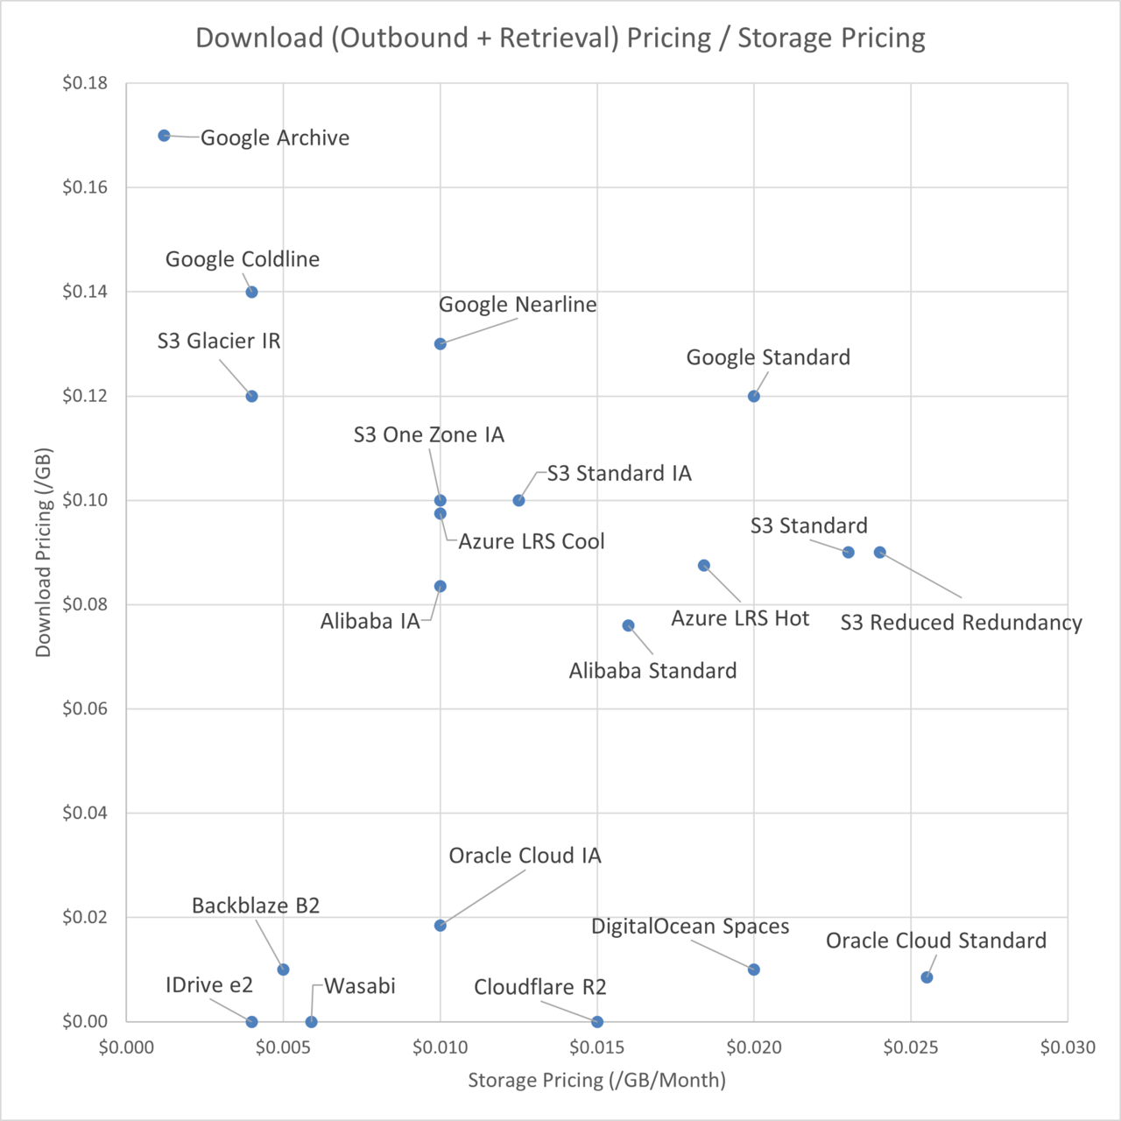
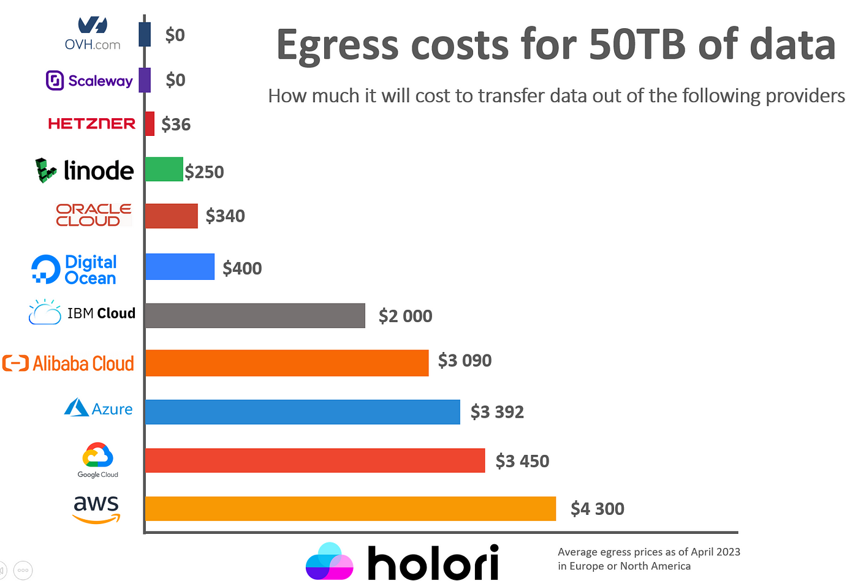
Dealing with EGRESS costs
~86$/TB / 86K $/PB
12M$ to retrieve the data ONCE

Slide 26
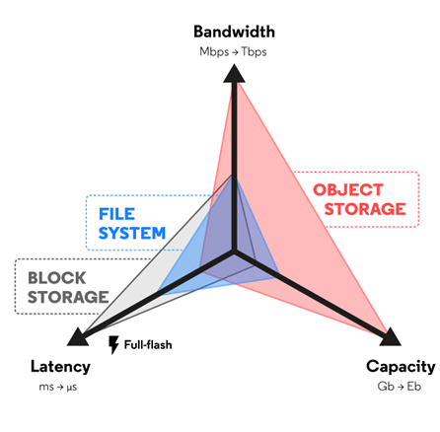
Why Object Storage
Amortize high latencies by:
bigger blocks,
smart compression algorithm (IDX2)
Caching data

Slide 27

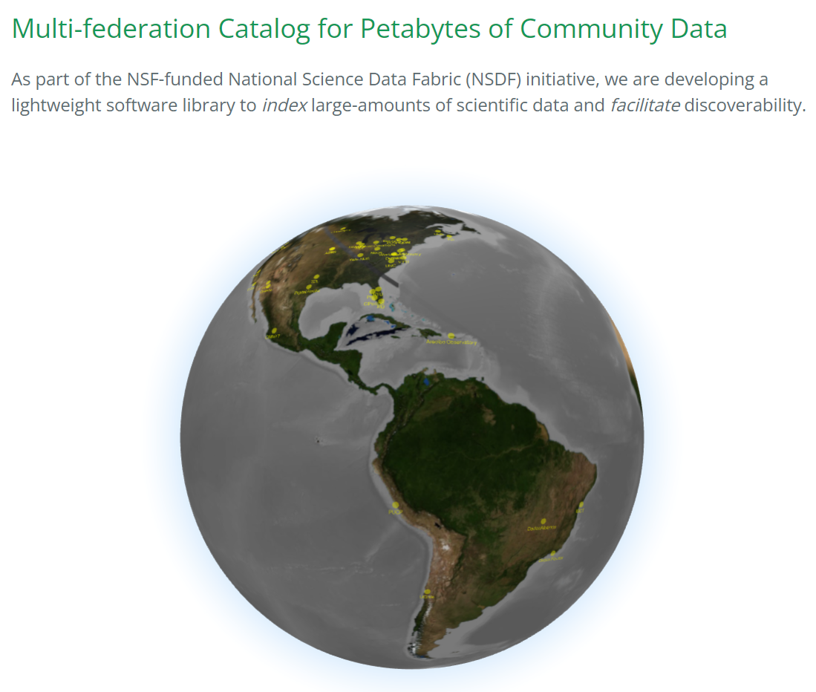
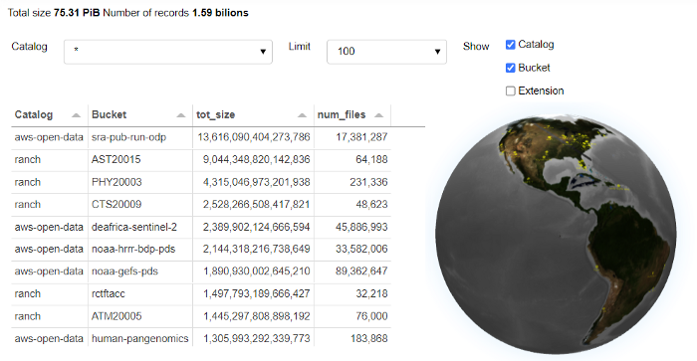
Multi-federation Catalog for Community Data records 75 PiB indexed = 2 billions of records
NSDF CATALOG
Arecibo Observatory
https://www.naic.edu/ao/landing
AWS Open Data
https://aws.amazon.com/opendata
CyVerse
https://cyverse.org
Digital Rock Portal
https://www.digitalrocksportal.org
Dryad
https://datadryad.org
Material Commons
https://materialscommons.org
Material Data Facility
https://materialsdatafacility.org
Neon Science
https://www.neonscience.org>
Zenodo
https://zenodo.org
Dataverse Abacus
http://abacus.library.ubc.ca
Dataverse Arab Council for the Social Scien\Ces (ACSS)
http://dataverse.theacss.org
Arca Dados Fiocrus - Dataverse
http://dadosdepesquisa.fiocruz.br
Arizona State University (ASU) Library Research Data Repository - Dataverse
http://dataverse.asu.edu
Austrian Social Science Data Archive (AUSSDA) - Dataverse
http://data.aussda.at
Borealis - Dataverse
http://borealisdata.ca
Center for International Forestry Research (CIFOR) - Dataverse
http://data.cifor.org
International Maize and Wheat Improvement Center (CIMMYT) - Dataverse
http://data.cimmyt.org
Catalan Open Research Data (CORA) - Dataverse
http://dataverse.csuc.cat
Croatian Social Science Data Archive (CROSSDA) - Dataverse
http://data.crossda.hr
The Chinese University of Hong Kong Library Research Data Repository (CUHK) - Dataverse
http://researchdata.cuhk.edu.hk
Dartmouth Institute for Health Policy and Clinical Practice (TDI) - Dataverse
http://dataverse.dartmouth.edu
Data Repository University of Stuttgart (DaRUS) - Dataverse
http://darus.uni-stuttgart.de
DataSuds Institut de recherche pour le développement (IRS) - Dataverse
http://dataverse.ird.fr
SceincesPo - Dataverse
https://data.sciencespo.fr
Edatos - Dataverse
http://edatos.consorciomadrono.es
Netherland - Dataverse
http://dataverse.nl
Norway - Dataverse
http://dataverse.no
Nanyang Technological University Singapore (NTU) - Dataverse
http://researchdata.ntu.edu.sg
Florida International University (FIU) Research Data Portal - Dataverse
http://dataverse.fiu.edu
Gottingen Research Online - Dataverse
http://data.goettingen-research-online.de
University of Harvard - Dataverse
http://dataverse.harvard.edu
Heidelberg Open Research Data - Dataverse
http://heidata.uni-heidelberg.de
Instituto Brasileiro de Informação em Ciencia e Tecnologia (IBICT) - Dataverse
http://repositoriopesquisas.ibict.br
Science of discovery to science of delivery (ICRISAT) - Dataverse
http://dataverse.icrisat.org
International Fertilizer Development Center (IFDC) - Dataverse
http://dataverse.ifdc.org
French Institute of Science and Technology for Transport, Development and Networks (IFSTTAR) -m Dataverse
http://research-data.ifsttar.fr
International Institute of Social History (IISG) - Dataverse
http://datasets.iisg.amsterdam
Institute of Russian Literature - Dataverse
http://dataverse.pushdom.ru
International Potato Center - Dataverse
http://data.cipotato.org
Italian Institute of Technology (IIT) - Dataverse
http://dataverse.iit.it
Johns Hopkins University - Dataverse
http://archive.data.jhu.edu
Forschungszentrum Julich - Dataverse
http://data.fz-juelich.de
University of Virginia (UVA) - Dataverse
http://dataverse.lib.virginia.edu
Repositori Ilmiah Nasional (RIN) - Dataverse
http://data.lipi.go.id
Lithuanian Data Archive for Social Sciences and Humanities (LiDA) - Dataverse
http://lida.dataverse.lt
International Center for Agricultural Research in Dry Ares (ICARDA) - Dataverse
http://data.mel.cgiar.org
Royal Netherlands Institute for Sea Research (NIOZ) - Dataverse
http://dataverse.nioz.nl
Universite catholique de Louvain - Dataverse
http://dataverse.uclouvain.be
Open Forest Data - Dataverse
http://dataverse.openforestdata.pl
Peking University - Dataverse
http://opendata.pku.edu.cn
Pontificia Universidad Catolica del Peru - Dataverse
http://datos.pucp.edu.pe
Qualitative Data Repository - Dataverse
http://data.qdr.syr.edu
Repositorio de datos de investigación de la Universidad de Chile - Dataverse
http://datos.uchile.cl
Repositorio de Datos de Investigación Universidad del Rosario - Dataverse
http://research-data.urosario.edu.co
Repositorios Piloto da Rede Nacional de Ensino e Pesquisa - Dataverse
http://dadosabertos.rnp.br
Riga Stradins University (RSU) - Dataverse
http://dataverse.rsu.lv
Texas Data Library (TDL) Repository - Dataverse
http://dataverse.tdl.org
University of California Los Angeles (UCLA) - Dataverse
http://dataverse.ucla.edu
University of New Brunswick (UNB) Libraries - Dataverse
http://dataverse.lib.unb.ca
University of North Carolina (UNC) - Dataverse
http://dataverse.unc.edu
University of Manitoba - Dataverse
http://dataverse.lib.umanitoba.ca
Universita degli Studi di Milano - Dataverse
http://dataverse.unimi.it
University of the West Indies (UWI) - Dataverse
http://dataverse.sta.uwi.edu
Virginia Tech Transportation Institute (VTTI) - Dataverse
http://dataverse.vtti.vt.edu
World Agroforestry Research Data Repository - Dataverse
http://data.worldagroforestry.org
Yale-NUS College - Dataverse
http://dataverse.yale-nus.edu.sg

Slide 28
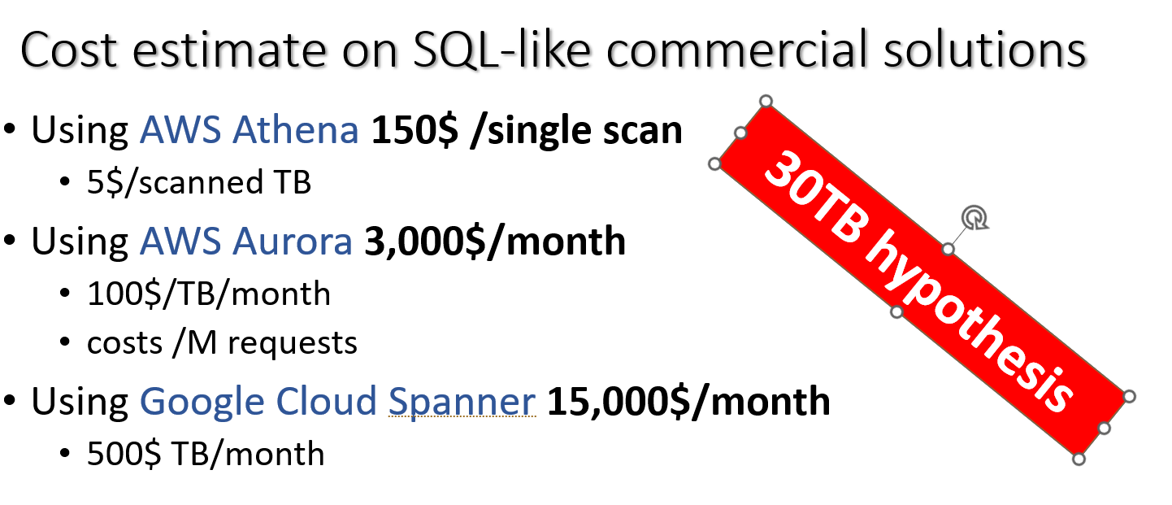
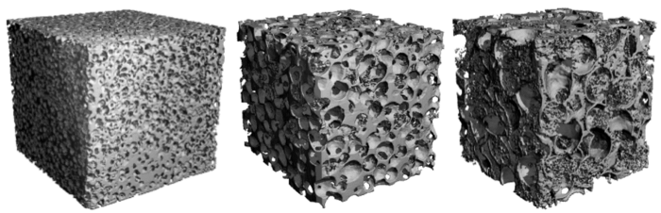
Answers at scale
The NSDF-Catalog helps to answer simple questions at scale.
How many objects are tagged X in Repository Y? FOAM keyword.
The catalog, processing 3GB/sec and 35 million rows/sec, can answer in 40 seconds.
We found 434 datasets with the FOAM keyword on AWS Open Data, 97 on Zenodo, and 21 on Dataverse Harvard.

Slide 29









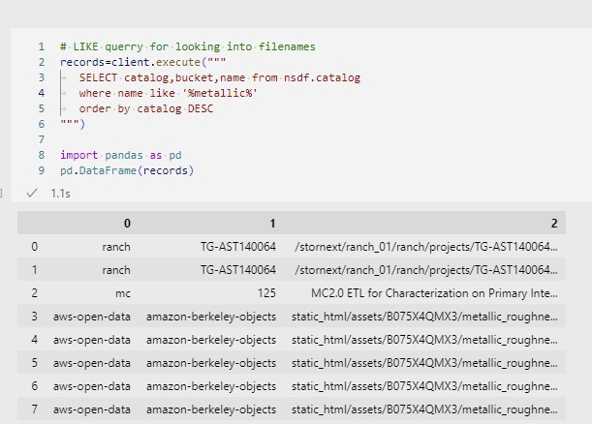

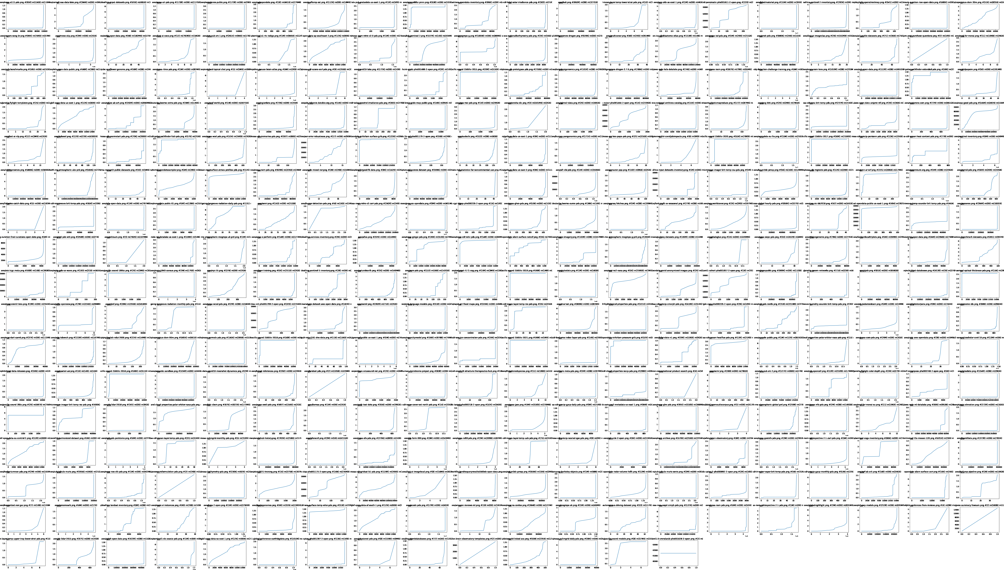
Searching for data across multiple repositories
OSDF
Search for experiments with “metallic” compound
AWS Open Data file size plotting.
Find patterns and enable caching

